Slide 1

Moving Beyond Linearity
Chapter 07

Slide 2
Moving Beyond Linearity
The truth is never linear!
Or almost never!
But often the linearity assumption is good enough.
When its not . . .
polynomials,
step functions,
splines,
local regression, and
generalized additive models
These methods offer a lot of flexibility without losing the ease and interpretability of linear models.

Slide 3
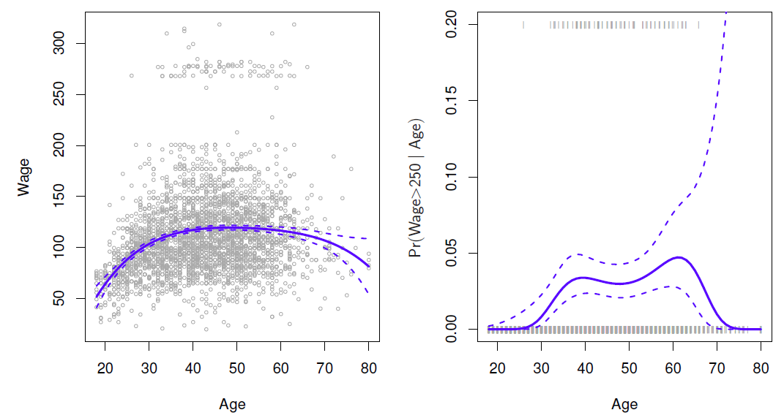

Polynomial Regression
$y_{i}= β_{0}+β_{1}x_{i}+β_{2}x_{i}^{2}+β_{3}x_{i}^{3}+…+β_{d}x_{i}^{d}+ε_{i}$
Degree – 4 Polynomial

Slide 4
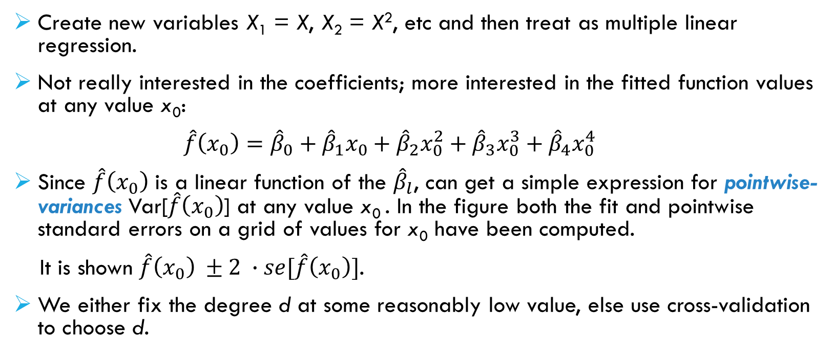
Details
Create new variables X₁ = X, X₂ = X², etc and then treat as multiple linear regression.
Not really interested in the coefficients; more interested in the fitted function values at any value x₀:
$\hat{f}\left(x_{0}\right)={\hat{β}}_{0}+{\hat{β}}_{1}x_{0}+{\hat{β}}_{2}x_{0}^{2}+{\hat{β}}_{3}x_{0}^{3}+{\hat{β}}_{4}x_{0}^{4}$
Since $\hat{f}\left(x_{0}\right)$ is a linear function of the ${\hat{β}}_{l}$, can get a simple expression for pointwise-variances Var[$\hat{f}\left(x_{0}\right)$] at any value x₀ . In the figure both the fit and pointwise standard errors on a grid of values for x₀ have been computed.
It is shown $\hat{f}\left(x_{0}\right) ±2 ∙se[\hat{f}\left(x_{0}\right)]$.
We either fix the degree d at some reasonably low value, else use cross-validation to choose d.

Slide 5
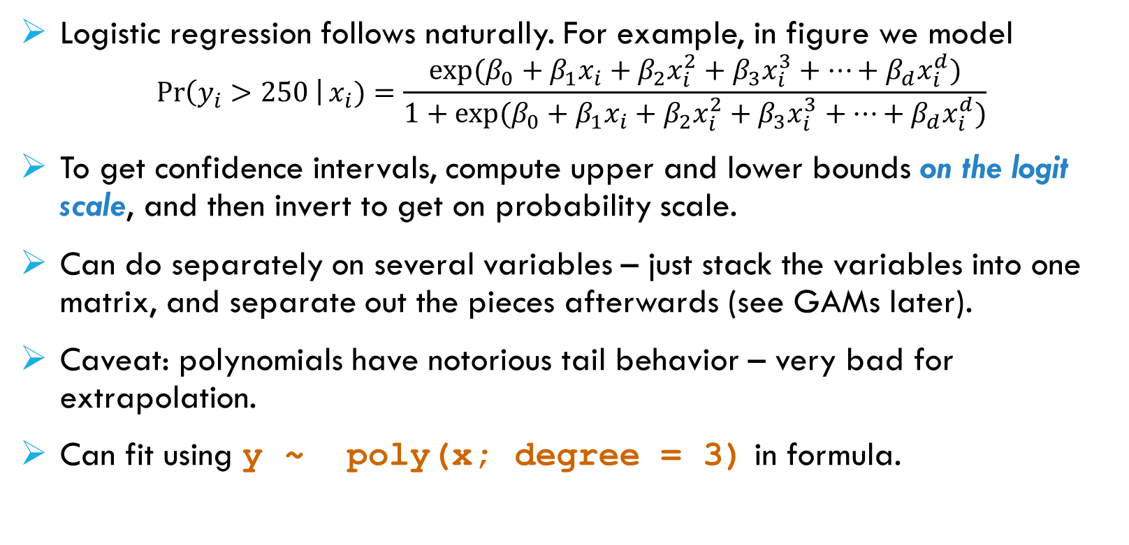
Details continued
Logistic regression follows naturally. For example, in figure we model
$$\operatorname{Pr}\left(y_{i}>250 \right|x_{i})=\frac{exp⁡(β_{0}+β_{1}x_{i}+β_{2}x_{i}^{2}+β_{3}x_{i}^{3}+…+β_{d}x_{i}^{d})}{1+exp⁡(β_{0}+β_{1}x_{i}+β_{2}x_{i}^{2}+β_{3}x_{i}^{3}+…+β_{d}x_{i}^{d})}$$
To get confidence intervals, compute upper and lower bounds on the logit scale, and then invert to get on probability scale.
Can do separately on several variables – just stack the variables into one matrix, and separate out the pieces afterwards (see GAMs later).
Caveat: polynomials have notorious tail behavior – very bad for extrapolation.
Can fit using y ~ poly(x; degree = 3) in formula.

Slide 6
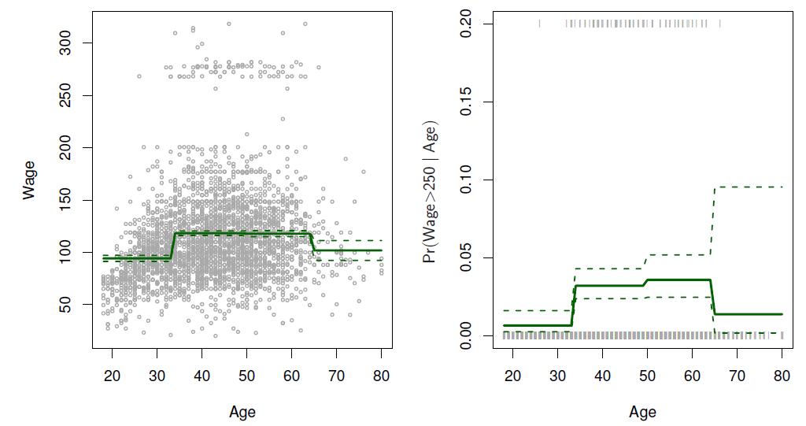
Step Functions
Another way of creating transformations of a variable – cut the variable into distinct regions.
C₁(X) = I(X < 35), C₂(X) = I(35 ≤ X < 50), . . . , C₃(X) = I(X ≥ 65)
Piecewise Constant

Slide 7
Step functions continued
Easy to work with. Creates a series of dummy variables representing each group.
Useful way of creating interactions that are easy to interpret. For example, interaction effect of Year and Age:
I(Year < 2005) ∙ Age, I(Year ≥ 2005) ∙ Age
would allow for different linear functions in each age category.
In R: I(year < 2005) or cut(age, c(18,25,40,65,90)).
Choice of cutpoints or knots can be problematic. For creating nonlinearities, smoother alternatives such as splines are available.

Slide 8
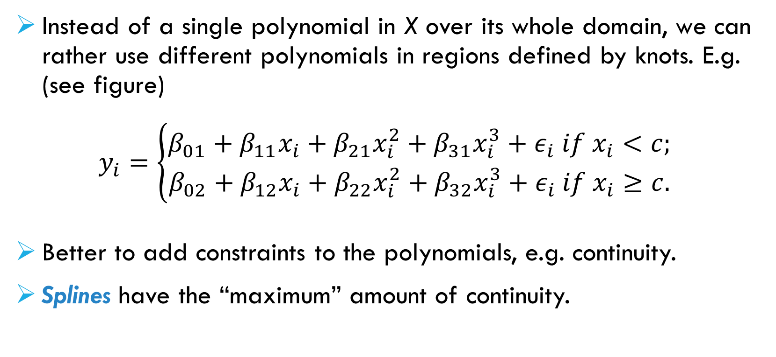
Piecewise Polynomials
Instead of a single polynomial in X over its whole domain, we can rather use different polynomials in regions defined by knots. E.g. (see figure)
$$y_{i}=\left\{\begin{matrix}β_{01}+β_{11}x_{i}+β_{21}x_{i}^{2}+β_{31}x_{i}^{3}+ε_{i} if x_{i}<c; \\ β_{02}+β_{12}x_{i}+β_{22}x_{i}^{2}+β_{32}x_{i}^{3}+ε_{i} if x_{i}≥c.\end{matrix}\right.$$
Better to add constraints to the polynomials, e.g. continuity.
Splines have the “maximum” amount of continuity.

Slide 9
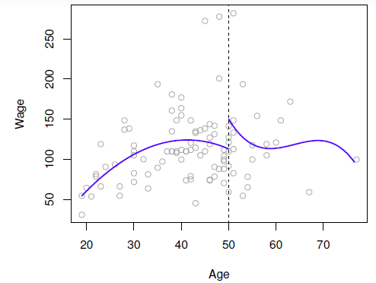
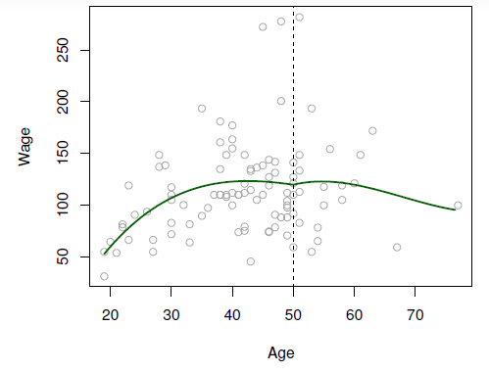
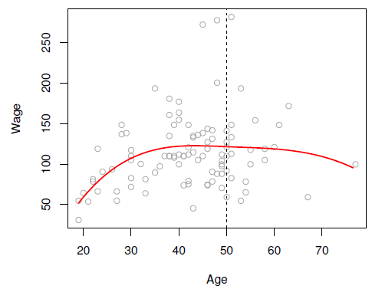
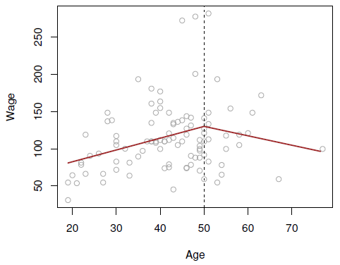
Piecewise Cubic
Continuous Piecewise Cubic
Cubic Spline
Linear Spline

Slide 10
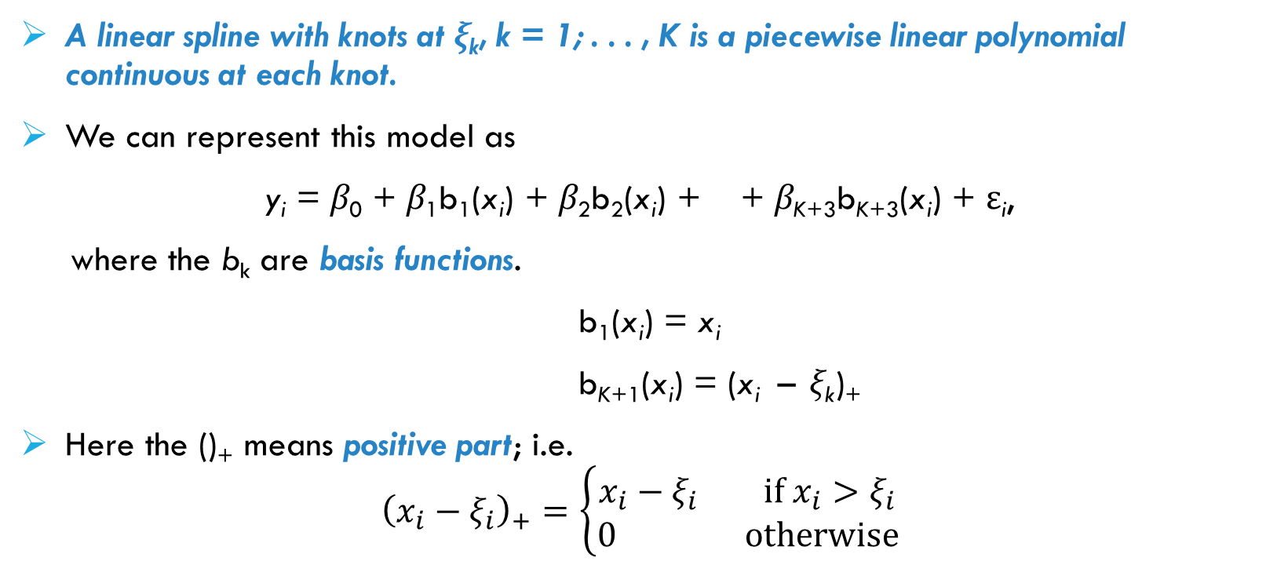
Linear Splines
A linear spline with knots at ξ_{k}, k = 1; . . . , K is a piecewise linear polynomial continuous at each knot.
We can represent this model as
y_{i} = β₀ + β₁b₁(x_{i}) + β₂b₂(x_{i}) + + β_{K+3}b_{K+3}(x_{i}) + ε_{i},
where the b_{k} are basis functions.
b₁(x_{i}) = x_{i}
b_{K+1}(x_{i}) = (x_{i} – ξ_{k})₊
Here the ()₊ means positive part; i.e.
$${\left(x_{i}−ξ_{i}\right)}_{+}=\left\{\begin{matrix}x_{i}−ξ_{i} if x_{i}>ξ_{i} \\ 0 otherwise\end{matrix}\right.$$

Slide 11
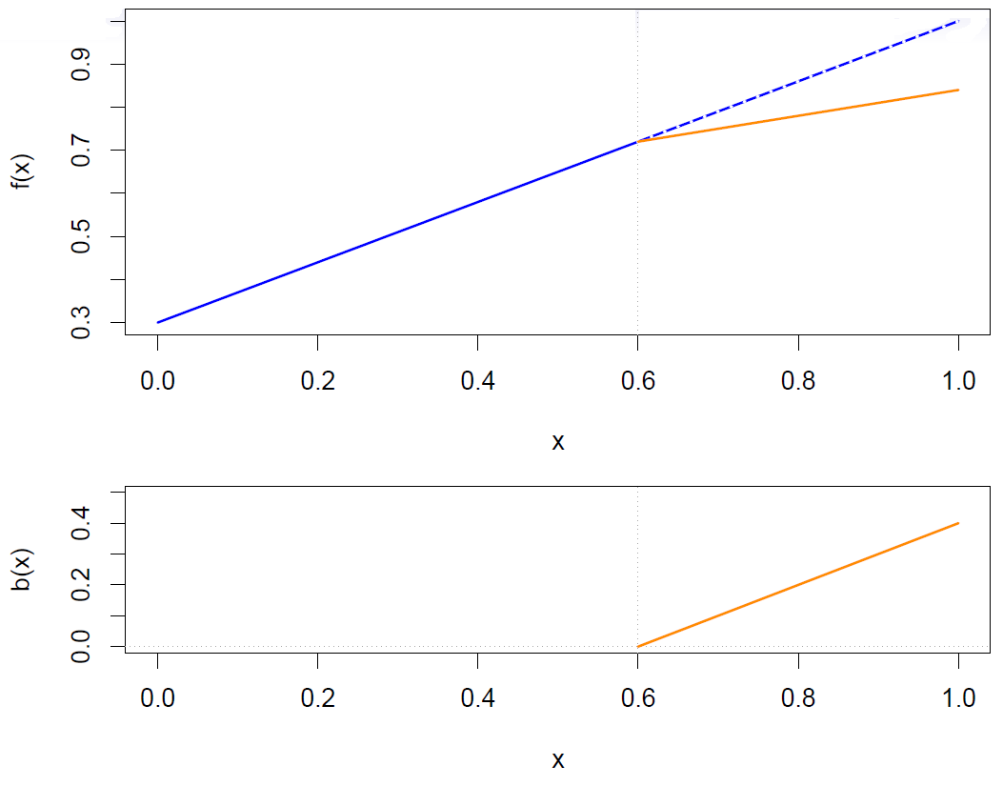

Slide 12
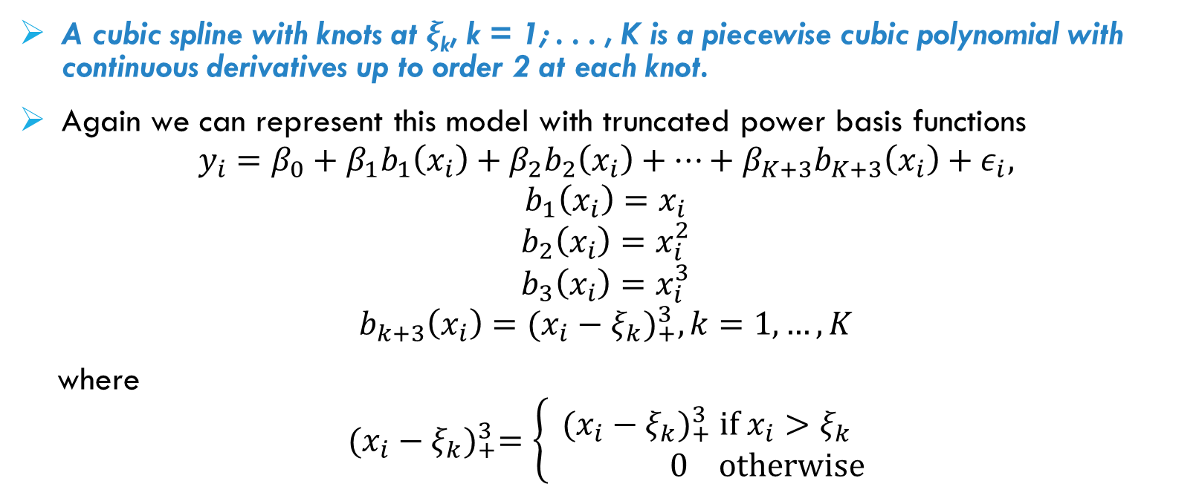
Cubic Splines
A cubic spline with knots at ξ_{k}, k = 1; . . . , K is a piecewise cubic polynomial with continuous derivatives up to order 2 at each knot.
Again we can represent this model with truncated power basis functions
$$y_{i}=β_{0}+β_{1}b_{1}\left(x_{i}\right)+β_{2}b_{2}\left(x_{i}\right)+…+β_{K+3}b_{K+3}\left(x_{i}\right)+ε_{i},$$
$$b_{1}\left(x_{i}\right)=x_{i}$$
$$b_{2}\left(x_{i}\right)=x_{i}^{2}$$
$$b_{3}\left(x_{i}\right)=x_{i}^{3}$$
$$b_{k+3}\left(x_{i}\right)={(x_{i}−ξ_{k})}_{+}^{3}, k=1, …,K$$
where
$${(x_{i}−ξ_{k})}_{+}^{3}=\left\{\begin{matrix}{(x_{i}−ξ_{k})}_{+}^{3} if x_{i}>ξ_{k} \\ 0 otherwise\end{matrix}\right.$$

Slide 13
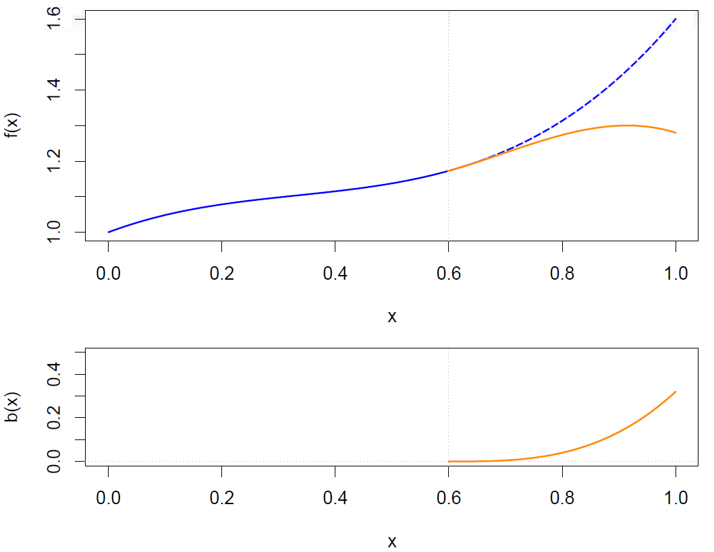

Slide 14
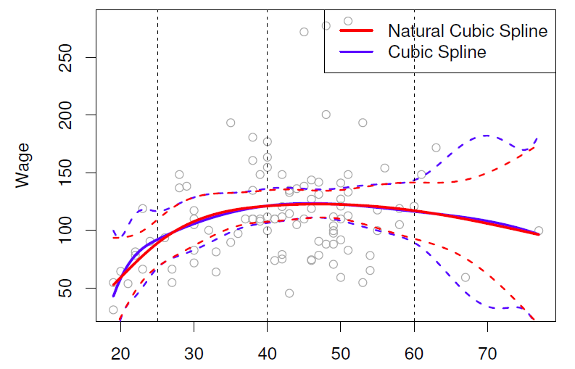
Natural Cubic Splines
A natural cubic spline extrapolates linearly beyond the boundary knots. This adds 4 = 2 x 2 extra constraints, and allows us to put more internal knots for the same degrees of freedom as a regular cubic spline.

Slide 15
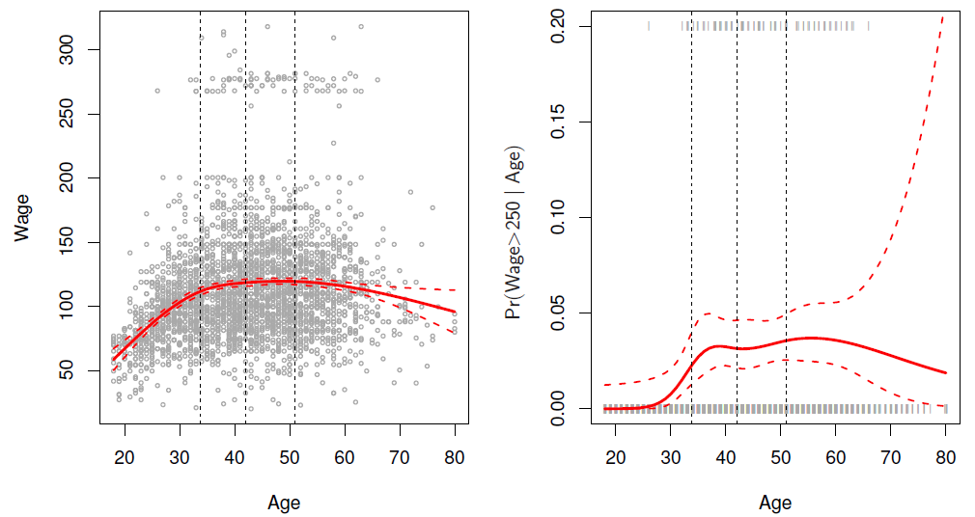
Fitting splines
Fitting splines in R is easy: bs(x, ...) for any degree splines, and ns(x, ...) for natural cubic splines, in package splines.
Natural Cubic Spline

Slide 16
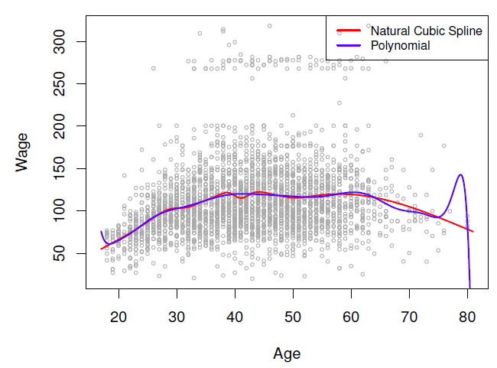
Knot placement
One strategy is to decide K, the number of knots, and then place them at appropriate quantiles of the observed X.
A cubic spline with K knots has K + 4 parameters or degrees of freedom.
A natural spline with K knots has K degrees of freedom.
Comparison of a degree-14 polynomial and a natural cubic spline, each
with 15df.
ns(age, df=14)
poly(age, deg=14)

Slide 17

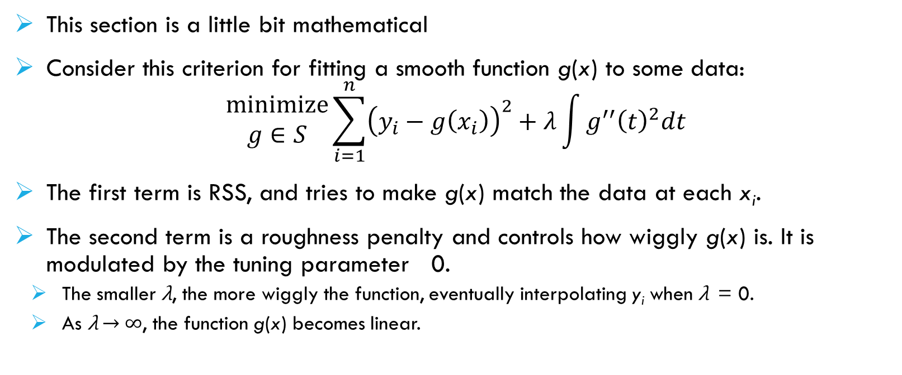
Smoothing splines
This section is a little bit mathematical
Consider this criterion for fitting a smooth function g(x) to some data:
$$\begin{matrix}minimize \\ g∈S\end{matrix}\sum_{i=1}^{n}{{\left(y_{i}−g\left(x_{i}\right)\right)}^{2}+λ\int{g^{′′}{\left(t\right)}^{2}dt}}$$
The first term is RSS, and tries to make g(x) match the data at each x_{i}.
The second term is a roughness penalty and controls how wiggly g(x) is. It is modulated by the tuning parameter 0.
The smaller λ, the more wiggly the function, eventually interpolating y_{i} when λ = 0.
As λ → ∞, the function g(x) becomes linear.

Slide 18
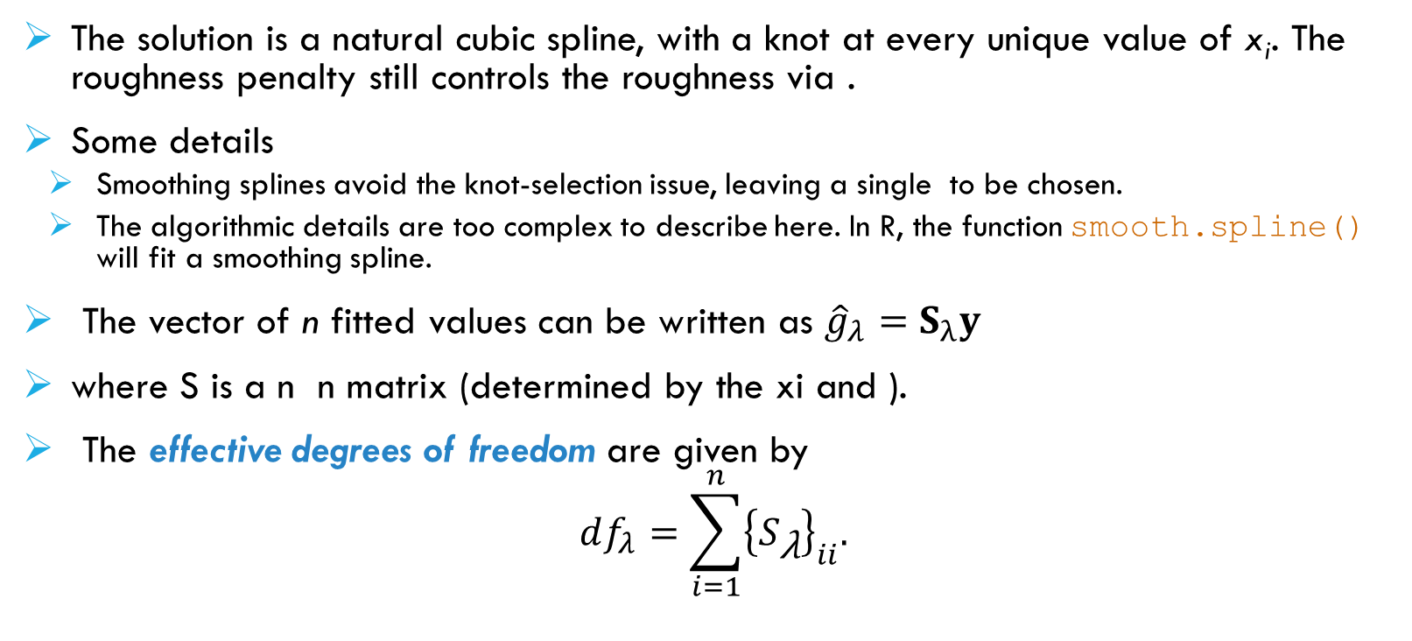
Smoothing Splines continued
The solution is a natural cubic spline, with a knot at every unique value of x_{i}. The roughness penalty still controls the roughness via .
Some details
Smoothing splines avoid the knot-selection issue, leaving a single to be chosen.
The algorithmic details are too complex to describe here. In R, the function smooth.spline() will fit a smoothing spline.
The vector of n fitted values can be written as ${\hat{g}}_{λ}=S_{λ}y$
where S is a n n matrix (determined by the xi and ).
The effective degrees of freedom are given by
$$df_{λ}=\sum_{i=1}^{n}{{\left\{S_{\text{λ}}\right\}}_{ii}.}$$

Slide 19
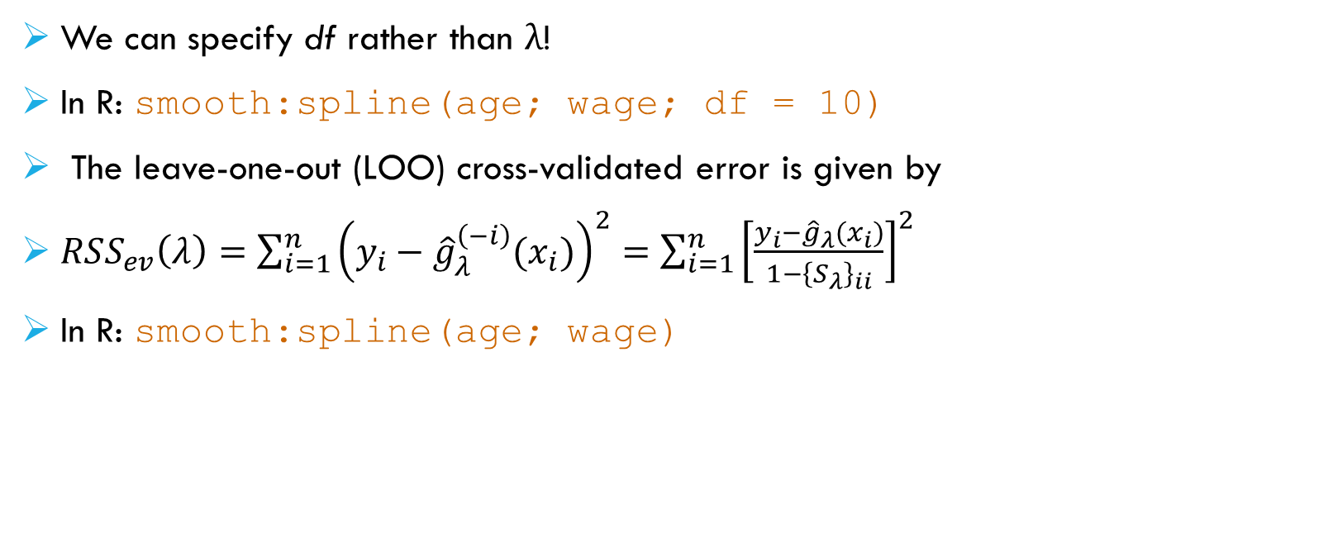
Smoothing Splines continued – choosing λ
We can specify df rather than λ!
In R: smooth:spline(age; wage; df = 10)
The leave-one-out (LOO) cross-validated error is given by
$RSS_{ev}\left(λ\right)=\sum_{i=1}^{n}{{\left(y_{i}−{\hat{g}}_{λ}^{\left(−i\right)}(x_{i})\right)}^{2}=\sum_{i=1}^{n}{{\left[\frac{y_{i}−{\hat{g}}_{λ}(x_{i})}{1−{\left\{S_{λ}\right\}}_{ii}}\right]}^{2}}}$
In R: smooth:spline(age; wage)

Slide 20
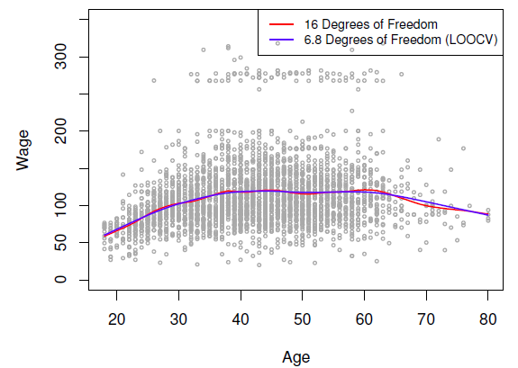
Smoothing Spline

Slide 21
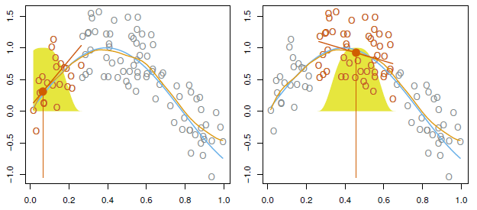
Local Regression
With a sliding weight function, we fit separate linear fits over the range of X by weighted least squares.
See text for more details, and loess() function in R.

Slide 22
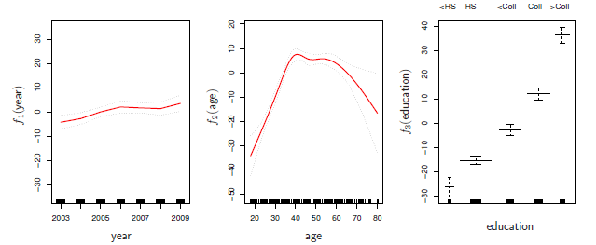
Generalized additive model
Allows for flexible nonlinearities in several variables, but retains the additive structure of linear models.
y_{i} = β₀ + f₁(x_{i1}) + f₂(x_{i2}) + . . . + f_{p}(x_{ip}) + ε_{i}.

Slide 23
GAM details
Can fit a GAM simply using, e.g. natural splines:
lm(wage ~ ns(year; df = 5) + ns(age; df = 5) + education)
Coecients not that interesting; fitted functions are. The previous plot was produced using plot.gam.
Can mix terms – some linear, some nonlinear – and use anova() to compare models.
Can use smoothing splines or local regression as well:
gam(wage ~ s(year; df = 5) + lo(age; span = :5) + education)
GAMs are additive, although low-order interactions can be included in a natural way using, e.g. bivariate smoothers or interactions of the form ns(age,df=5):ns(year,df=5).

Slide 24
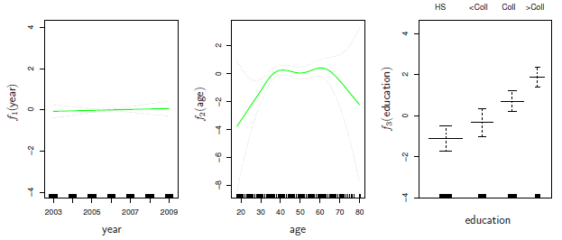

GAMs for classication
$log\left(\frac{p(X)}{1−p(X)}\right)=β_{0}+f_{1}\left(X_{1}\right)+f_{2}\left(X_{2}\right)+…+f_{p}\left(X_{p}\right).$
gam(I(wage > 250) year + s(age; df = 5) + education; family = binomial)

